Slide 1
Open RAN
Dian Hanifudin Subhi

Slide 2
Outline
Weekly report
Summary of this week’s work
Your work
Conclusion
Your opinion/thought
Action item

Slide 3
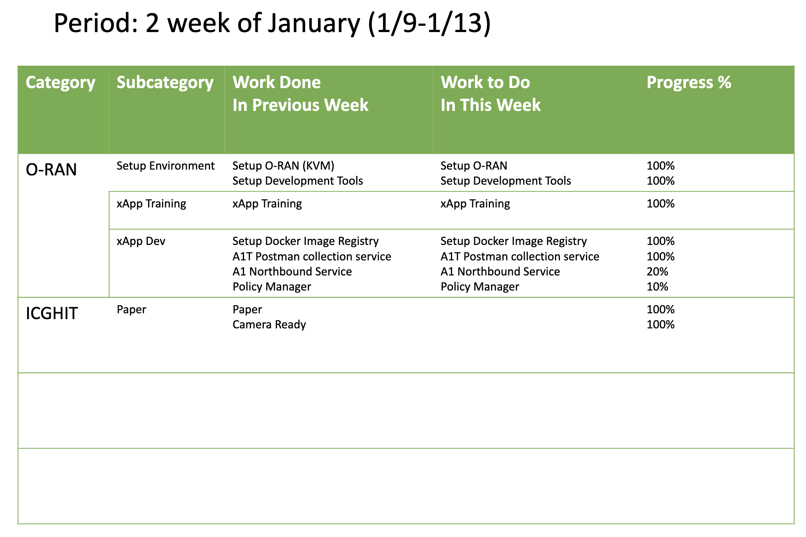
Weekly report

Slide 4
Summary of work this week
Explore communication xApp to support Lab case

Slide 5
Question to be Answered
How basic flow communication xApp?
What’s service needed to support lab case?

Slide 6
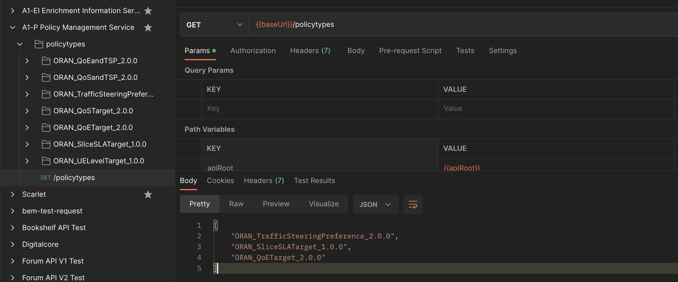
Your work
A1T Postman Testing
Postman Rest Client:
Testing A1T endpoint

Slide 7
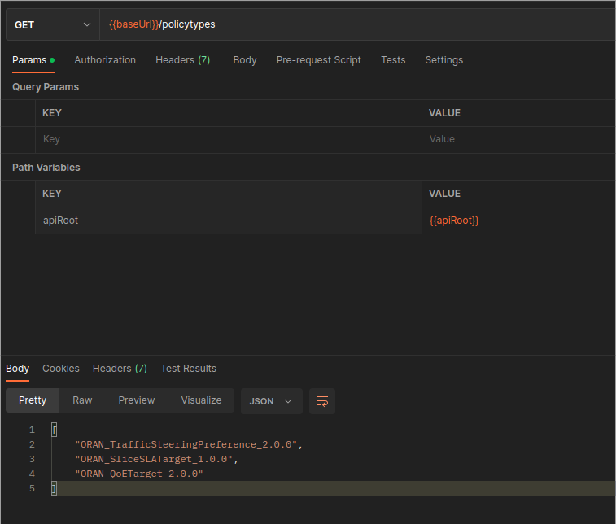
Your work
A1T Postman Testing
One policy management represented as one xApp

Slide 8
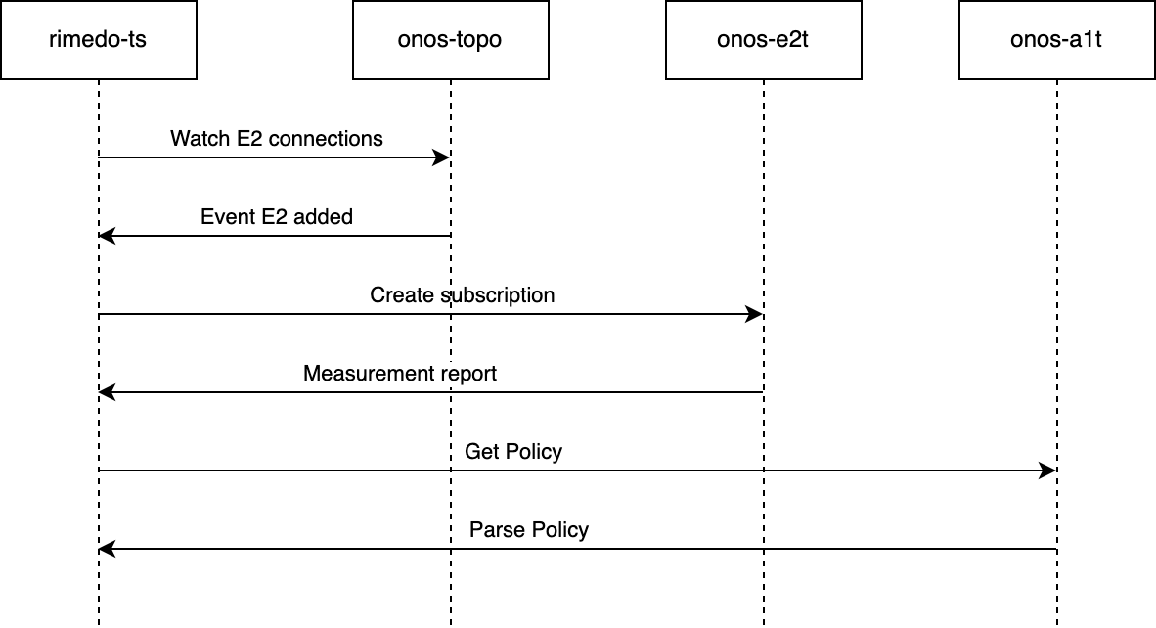
Your work
Basic flow of xApp
To be discussed
ServiceModel needed to support Lab case
ONF Slack recommend using Key Performance Metrics (E2SM_KPM) or develop own service model.
Policy management to support Lab case candidates:
Slice SLA target (QRA-xApp)
QoS Target
QoE Target

Slide 9
Your work
Additional component to support Lab case
onos-rsm:
The xApplication for ONOS-SDRAN (µONOS Architecture) to manage RAN slices
Features:
Create, Update, Delete Slice
UE slice allocation

Slide 10
Conclusion
E2SM_KPM needed to gather information from E2
There are policy management candidates: SLA target, QoS target and QoE target.
Integration with onos-rsm needed to support lab case.

Slide 11
Your opinion/thought
A suitable service model and policy management are required to support the Lab case.

Slide 12
Action items
Implement Lab case using QRA-xApp as a reference
Trial and error for available service model and policy management

